Slide 1

Ideas for Advocacy Projects
Psychology of Women
Dr. Laura Ramsey
Bridgewater State University

Slide 2

How to Get Started
Select a topic that you care about
  What issues related to women/gender do you find yourself thinking about outside of class?
  What issue related to women/gender is relevant to your future career?
  How are you affected by a gendered issue? It’s okay to make it personal!
Pinpoint a problem that needs to be addressed within that topic
  Consult research on that topic
  Find out about people affected by that issue
  Find out about relevant organizations

Slide 3

Plan Your Action
Raise awareness on an issue
  Write a letter to the editor, start a social media campaign, give talks to relevant groups
Advocating for policy changes
  Inform & persuade powerful people: legislators, leaders of organizations, etc.
Volunteer for an event that it is already happening
  Example: Greenlight for Girls, Sexual Assault Awareness month
Volunteer with an organization
  Examples: Girls Inc., South Shore Women’s Resource Center

Slide 4
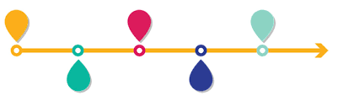
Timeline
Today: start brainstorming
Next couple of weeks: do any necessary research to pinpoint the issue and action that you want to take
March 20: bring draft of your advocacy project plan to class
April 1: Advocacy Project Plan due
First few weeks of April: execute the plan
April 24: bring draft of advocacy project paper to class
May 1: Advocacy Project Paper due

Slide 5

Right Now
Brainstorm what issue you’d like to work on
  What exactly is the problem?
  What needs to change?
Brainstorm how you might go about affecting that issue
  Possible approaches: raise awareness, advocate for policy changes, find an event or organization already working on this issue, ???

